Slide 1
Data Warehouse for FudgeMart Inc.
IST 722: Data Warehouse
Fall 2019
Mentor: Prof. P. Taber
Guide: Yash Kapadia

Slide 2
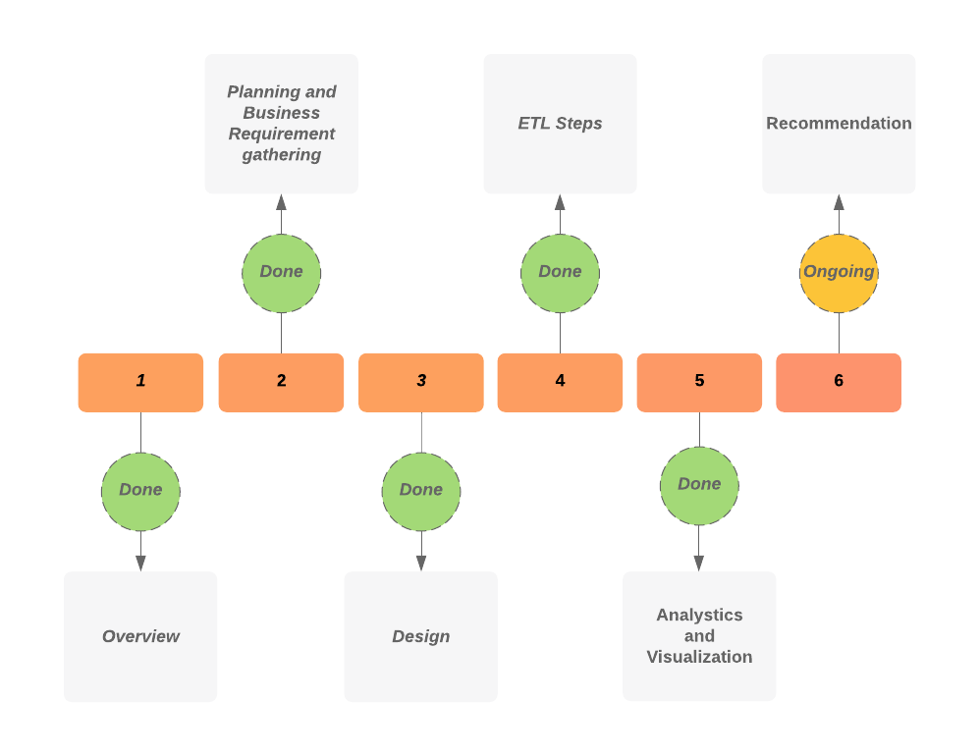
Project Plan Agenda

Slide 3




Project Team
Palaniappan M
Data Engineer
Vijay Bhat
Project Manager
Shashank Srihari
BI Developer
Tanya Shrivastava
ETL Specialist

Slide 4
Overview
FudgeMart: Online retailer company similar to amazon or Walmart. It contains several tables including customers, product reviews, orders and credit card credentials. It also contains employee information, product details and vendor details.
FudgeFlix: It is a fictitious online DVD by mail and video on demand service, like Netflix DVD. The database for Fudgeflix is called Fudgeflix_v3 and contains concepts such as accounts, subscriptions and video titles as well as other things associated with an online video streaming service
ExternalSources: Some useful data tables such survey data collected on Fudgemart customers such as email, twitter usernames, marital status, addresses, and customer’s social media discussion related to Fudgemart’s products

Slide 5
Approach
Execution of staging of the relevant data
Performing ETL processes using SSIS packages on the data
Designing a data warehouse
Generating meaningful insights using Business Intelligence

Slide 6
Stakeholders
Project Team
Project Sponsor
Users [Fudgemart Inc. Employees]
Internal Audit and Performance

Slide 7
Project Deliverables
Project Proposal
High-level dimensional modeling worksheet
Detail-level dimensional modeling worksheet
Data Warehouse on SQL Server
Initial ETL done in SSIS
Business Intelligence Dashboard
Presentation and Demonstration

Slide 8
Identified Business Processes
Analyzing Product Review Stars
Movie Popularity
Aggregated Sales Reporting
Customer Promotional Strategy

Slide 9
Implemented Processes
Product Review Stars: Analyzing Products reviewed by Customers based on the star rating on the scale of 1-5. These are drilled down by month of sale, city of customer, category of the product and region sold.
Aggregated Sales Reporting: Aggregating Customers from Fudgemart and Fudgeflix and analyzing sales by region, month, the day of the week. Highest selling products are also identified.

Slide 10
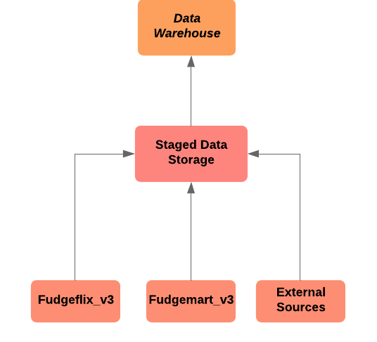
ETL Steps

Slide 11
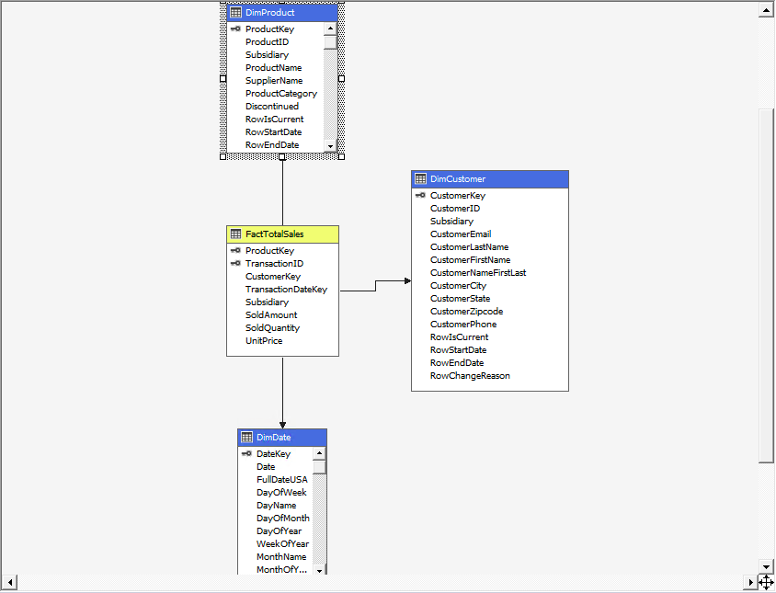
Design

Slide 12
Business Intelligence Aggregate Sales

Slide 13
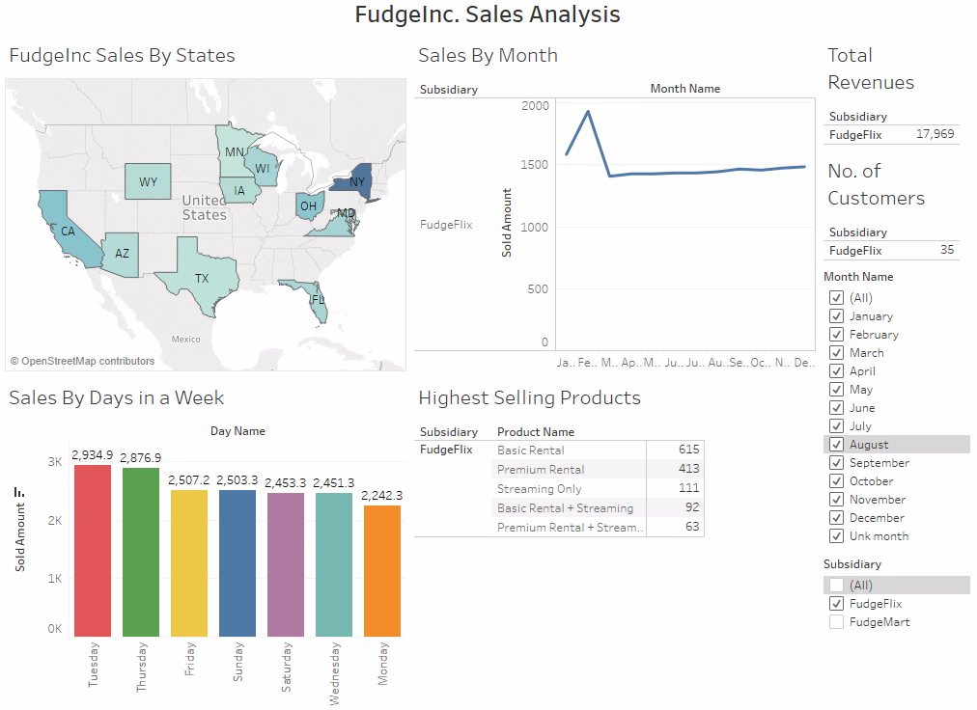

Slide 14
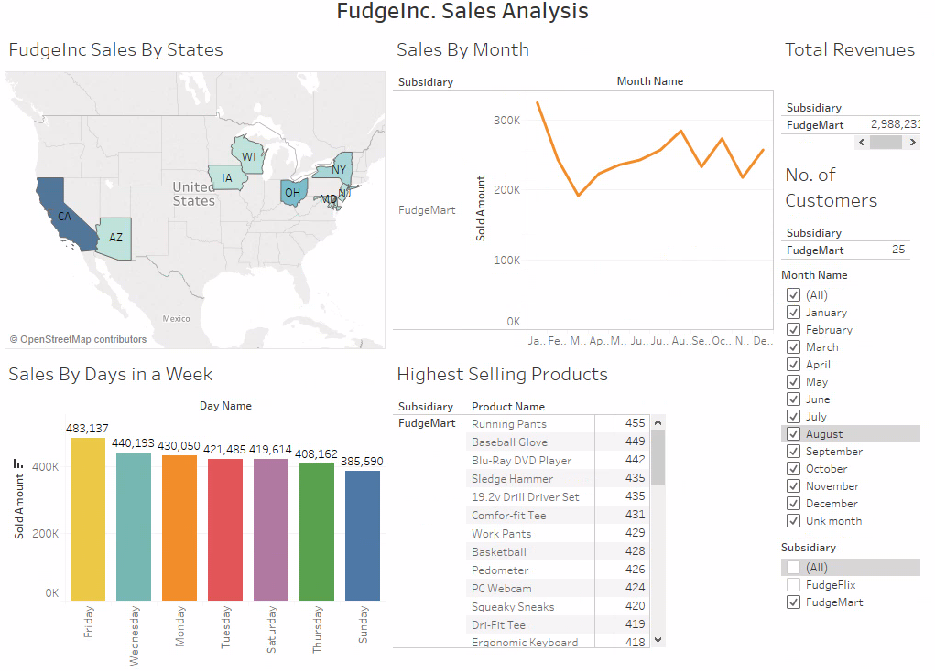

Slide 15
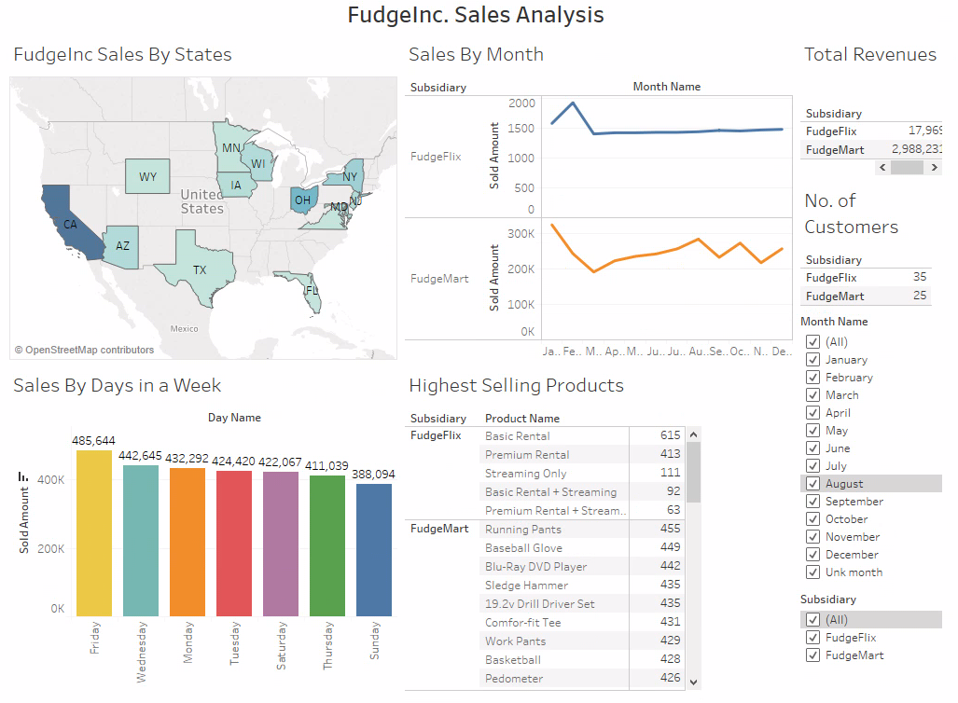

Slide 16
Business Intelligence Product Review Star

Slide 17
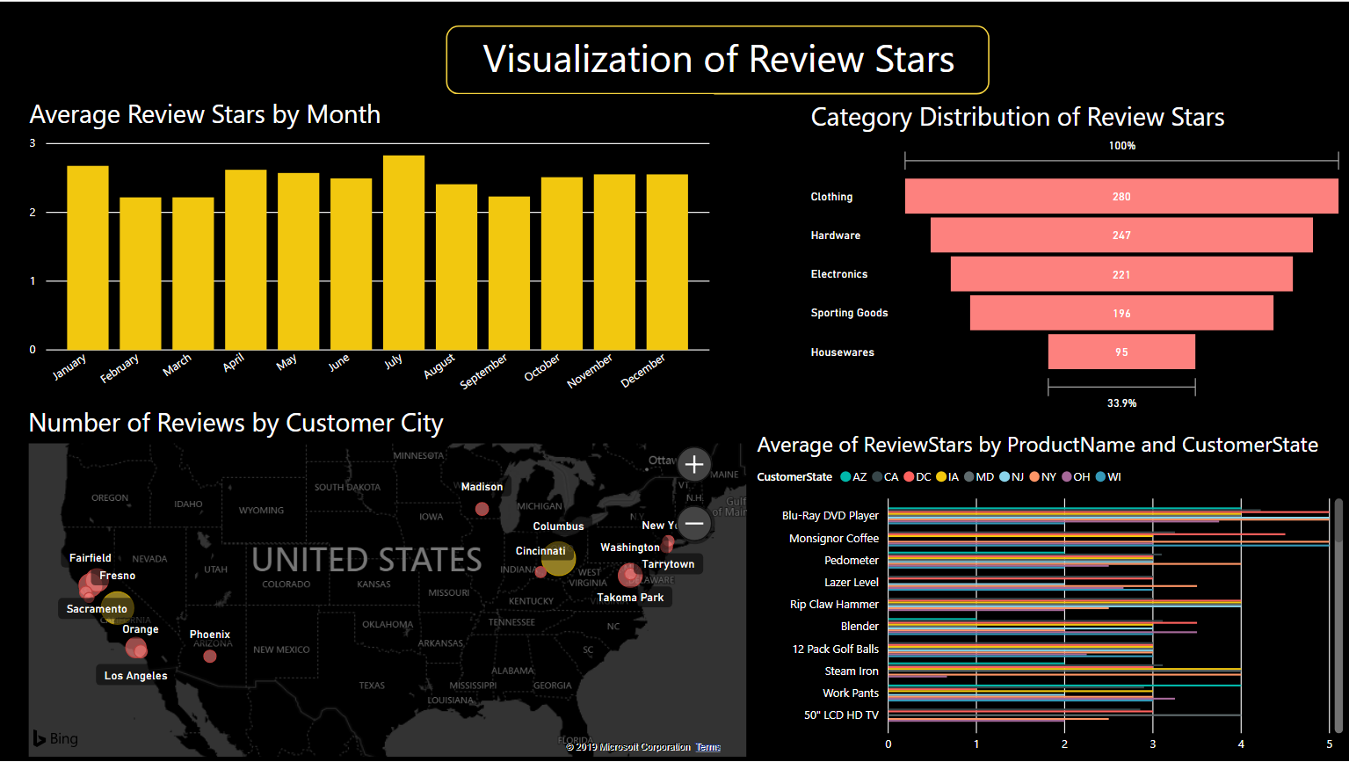

Slide 18
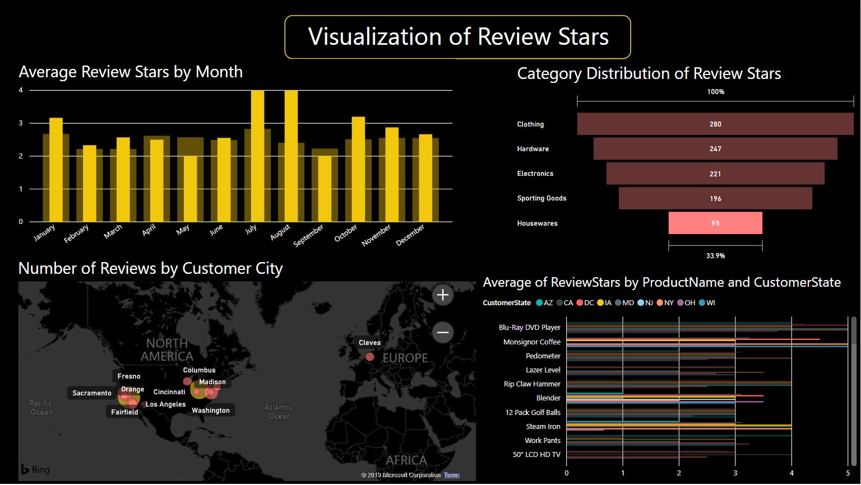

Slide 19
Maintenance & Internal Audit of a Data Warehouse
Back up all the system and user databases.
Keep record of all the service packs installed for Microsoft SQL server and the authentication password and usernames.
Test system recovery in advance and alter the process accordingly.
Perform Data Exposure analysis to record down-time and data losses for system failures.
Keep data files to a minimum size by deleting empty files and conserve disk space.
Regular consistency checks for data.

Slide 20
Thank you!
Questions?

